Slide 1

8
THE DATA OF MACROECONOMICS

Slide 2
23
Measuring a Nation’s Income

Slide 3
Measuring a Nation’s Income
Microeconomics
  Microeconomics is the study of how individual households and firms make decisions and how they interact with one another in markets.
Macroeconomics
  Macroeconomics is the study of the economy as a whole.
  Its goal is to explain the economic changes that affect many households, firms, and markets at once.

Slide 4
Measuring a Nation’s Income
Macroeconomics answers questions like the following:
  Why is average income high in some countries and low in others?
  Why do prices rise rapidly in some time periods while they are more stable in others?
  Why do production and employment expand in some years and contract in others?

Slide 5
THE ECONOMY’S INCOME AND EXPENDITURE
When judging whether the economy is doing well or poorly, it is natural to look at the total income that everyone in the economy is earning.

Slide 6
THE ECONOMY’S INCOME AND EXPENDITURE
For an economy as a whole, income must equal expenditure because:
  Every transaction has a buyer and a seller.
  Every dollar of spending by some buyer is a dollar of income for some seller.

Slide 7
THE MEASUREMENT OF GROSS DOMESTIC PRODUCT
Gross domestic product (GDP) is a measure of the income and expenditures of an economy.
It is the total market value of all final goods and services produced within a country in a given period of time.

Slide 8
THE MEASUREMENT OF GROSS DOMESTIC PRODUCT
The equality of income and expenditure can be illustrated with the circular-flow diagram.

Slide 9

Figure 1 The Circular-Flow Diagram
MARKETS
Revenue
FOR
Spending
GOODS AND SERVICES
Goods
Firms sell
Goods and
and services
Households buy
services
sold
bought
FIRMS
HOUSEHOLDS
Produce and sell
Buy and consume
goods and services
goods and services
Hire and use factors
Own and sell factors
of production
of production
Factors of
MARKETS
Labor, land,
production
FOR
and capital
FACTORS OF PRODUCTION
Wages, rent,
Households sell
Income
and profit
Firms buy
= Flow of inputs
and outputs
= Flow of dollars
Copyright © 2004 South-Western

Slide 10
THE MEASUREMENT OF GROSS DOMESTIC PRODUCT
GDP is the market value of all final goods and services produced within a country in a given period of time.

Slide 11
THE MEASUREMENT OF GROSS DOMESTIC PRODUCT
“GDP is the Market Value . . .”
  Output is valued at market prices.
“. . . Of All Final . . .”
  It records only the value of final goods, not intermediate goods (the value is counted only once).
“. . . Goods and Services . . . “
  It includes both tangible goods (food, clothing, cars) and intangible services (haircuts, housecleaning, doctor visits).

Slide 12
THE MEASUREMENT OF GROSS DOMESTIC PRODUCT
“. . . Produced . . .”
  It includes goods and services currently produced, not transactions involving goods produced in the past.
“ . . . Within a Country . . .”
  It measures the value of production within the geographic confines of a country.

Slide 13
THE MEASUREMENT OF GROSS DOMESTIC PRODUCT
“. . . In a Given Period of Time.”
  It measures the value of production that takes place within a specific interval of time, usually a year or a quarter (three months).

Slide 14
THE COMPONENTS OF GDP
GDP includes all items produced in the economy and sold legally in markets.

Slide 15
THE COMPONENTS OF GDP
What Is Not Counted in GDP?
  GDP excludes most items that are produced and consumed at home and that never enter the marketplace.
  It excludes items produced and sold illicitly, such as illegal drugs.

Slide 16
THE COMPONENTS OF GDP
GDP (Y) is the sum of the following:
  Consumption (C)
  Investment (I)
  Government Purchases (G)
  Net Exports (NX)
Y = C + I + G + NX

Slide 17
THE COMPONENTS OF GDP
Consumption (C):
  The spending by households on goods and services, with the exception of purchases of new housing.
Investment (I):
  The spending on capital equipment, inventories, and structures, including new housing.

Slide 18
THE COMPONENTS OF GDP
Government Purchases (G):
  The spending on goods and services by local, state, and federal governments.
  Does not include transfer payments because they are not made in exchange for currently produced goods or services.
Net Exports (NX):
  Exports minus imports.

Slide 19

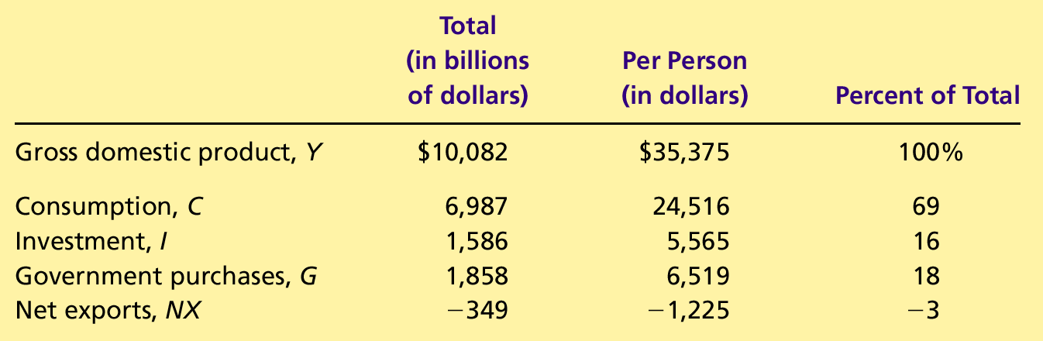
Table 1 GDP and Its Components
Copyright©2004 South-Western

Slide 20
GDP and Its Components (2001)
Government Purchases
18%
Net Exports
-3 %
Investment
16%
Consumption
69%

Slide 21
REAL VERSUS NOMINAL GDP
Nominal GDP values the production of goods and services at current prices.
Real GDP values the production of goods and services at constant prices.

Slide 22
REAL VERSUS NOMINAL GDP
An accurate view of the economy requires adjusting nominal to real GDP by using the GDP deflator.

Slide 23
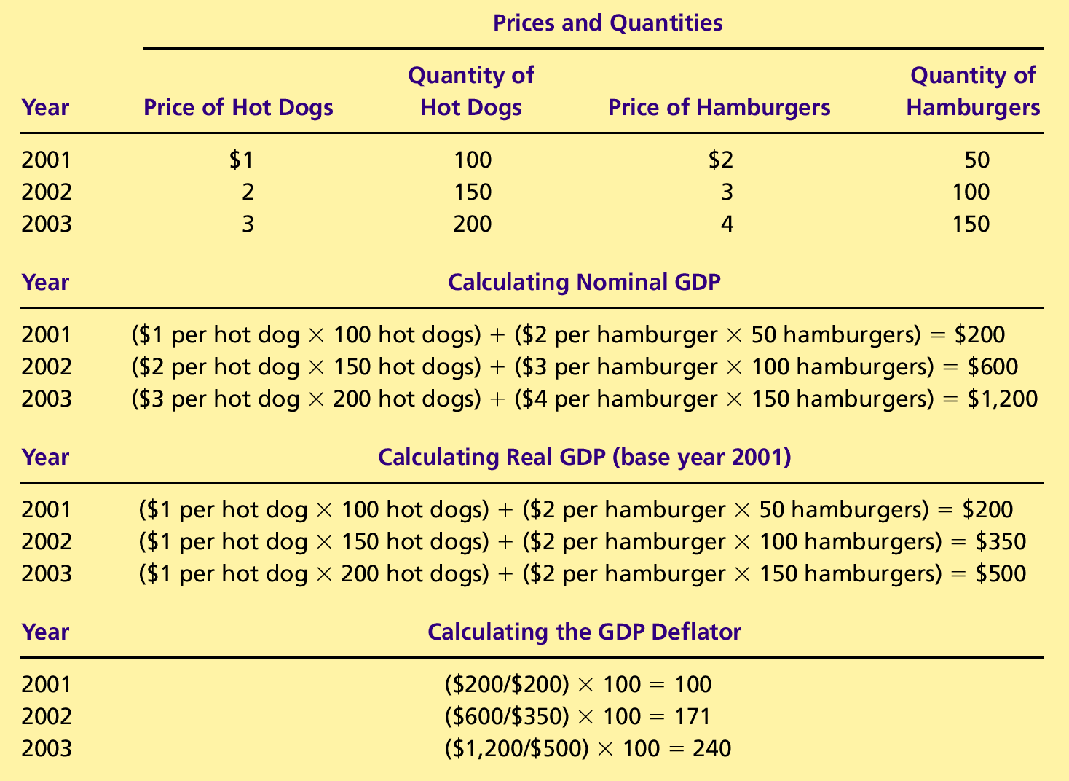
Table 2 Real and Nominal GDP
Copyright©2004 South-Western

Slide 24
Table 2 Real and Nominal GDP
Copyright©2004 South-Western

Slide 25
Table 2 Real and Nominal GDP
Copyright©2004 South-Western

Slide 26
The GDP Deflator
The GDP deflator is a measure of the price level calculated as the ratio of nominal GDP to real GDP times 100.
It tells us the rise in nominal GDP that is attributable to a rise in prices rather than a rise in the quantities produced.

Slide 27
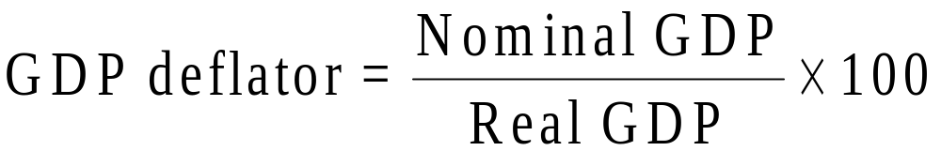
The GDP Deflator
The GDP deflator is calculated as follows:

Slide 28
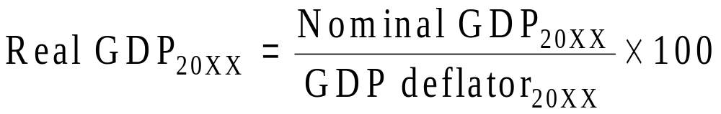
The GDP Deflator
Converting Nominal GDP to Real GDP
  Nominal GDP is converted to real GDP as follows:

Slide 29
Table 2 Real and Nominal GDP
Copyright©2004 South-Western

Slide 30
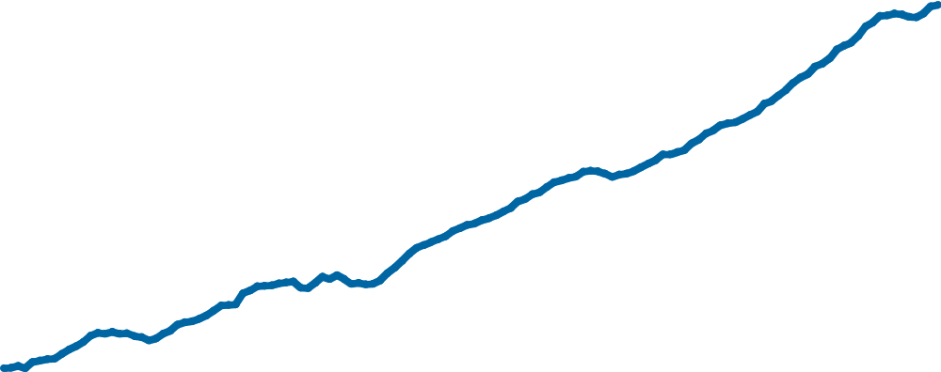
Figure 2 Real GDP in the United States
Billions of
1996 Dollars
$10,000
9,000
8,000
7,000
6,000
5,000
4,000
3,000
1970
1975
1980
1985
1990
1995
2000
Copyright © 2004 South-Western

Slide 31
GDP AND ECONOMIC WELL-BEING
GDP is the best single measure of the economic well-being of a society.
GDP per person tells us the income and expenditure of the average person in the economy.

Slide 32
GDP AND ECONOMIC WELL-BEING
Higher GDP per person indicates a higher standard of living.
GDP is not a perfect measure of the happiness or quality of life, however.

Slide 33
GDP AND ECONOMIC
WELL-BEING
Some things that contribute to well-being are not included in GDP.
  The value of leisure.
  The value of a clean environment.
  The value of almost all activity that takes place outside of markets, such as the value of the time parents spend with their children and the value of volunteer work.

Slide 34
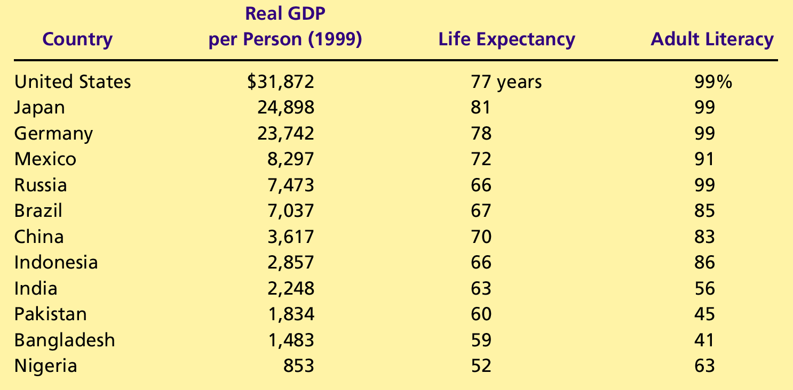
Table 3 GDP, Life Expectancy, and Literacy
Copyright©2004 South-Western

Slide 35
Summary
Because every transaction has a buyer and a seller, the total expenditure in the economy must equal the total income in the economy.
Gross Domestic Product (GDP) measures an economy’s total expenditure on newly produced goods and services and the total income earned from the production of these goods and services.

Slide 36
Summary
GDP is the market value of all final goods and services produced within a country in a given period of time.
GDP is divided among four components of expenditure: consumption, investment, government purchases, and net exports.

Slide 37
Summary
Nominal GDP uses current prices to value the economy’s production. Real GDP uses constant base-year prices to value the economy’s production of goods and services.
The GDP deflator—calculated from the ratio of nominal to real GDP—measures the level of prices in the economy.

Slide 38
Summary
GDP is a good measure of economic well-being because people prefer higher to lower incomes.
It is not a perfect measure of well-being because some things, such as leisure time and a clean environment, aren’t measured by GDP.

